Slide 1
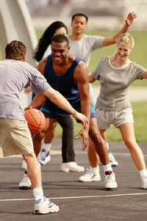
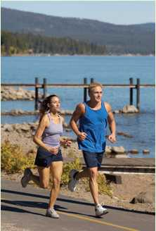
CONCEPT OF FITNESS

Slide 2
FITNESS
The ability to perform daily task vigorously and alertly, with energy left over for enjoying leisure time activity and emergency demands. It is the ability to endure, to bear up, to withstand stress, to carry on in circumstances where unfit person could not continue, and is a major basic for good health and well-being. Participating in physical activity is beneficial to people of all ages. Physical activity contributes to fitness, a state in which people’s health characteristics and behaviors enhance the quality of their lives. A set of physical attributes related to a person’s ability to perform physical activity successfully, without undue strain and with a margin of safety.

Slide 3
TYPES OF FITNESS
1. Health-related physical fitness
A physiological state of well-being that reduces the risk of hypokinetic disease; a basis for participation in sports; and a vigor for the tasks of daily living. Components include cardio-respiratory endurance, muscle strength endurance, flexibility, and body composition.

Slide 4
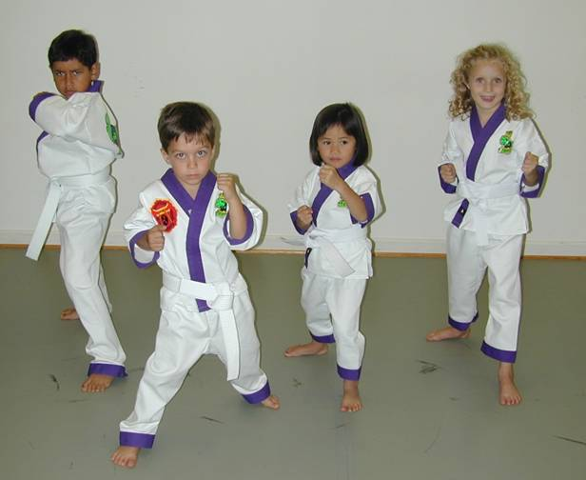
2. Skill-related physical fitness
Common components of physical fitness (e.g., agility, balance, coordination, speed, power, reaction time) that enable participation in sports and other physical activities; also called performance or motor fitness.

Slide 5
COMPONENT OF FITNESS
1. Strength: The extent to which muscles can exert force by contracting against resistance.
2. Power: The ability to exert maximum muscular contraction intensely in an explosive burst of movement. e.g. jumping, sprinting start
3. Speed: The quick movement of limbs, whether leg of sprinter or arms of shot putter.
4. Agility: The ability to perform a series of explosive power movements in rapid succession in opposing directions.

Slide 6
5. Balance: The ability to control the body’s position either in stationary or moving position.
6. Flexibility: The ability to achieve an extended range of motion without being impeded by excess tissues.
7. Muscular Endurance: A single muscle ability to perform sustained work, e.g. rowing, cycling.
8. Cardiovascular Endurance: The heart’s ability to deliver blood to working muscles and their ability to use it, e.g. long distance running.
9. Strength Endurance: A muscle’s ability to perform a maximum contraction against resistance.
10. Co-ordination: The ability to perform effectively with other components.

Slide 7
BENEFITS/scope OF FITNESS
Improves health:
Increase efficiency of heart and lungs.
Reduce cholesterol level.
Increase muscular strength.
Reduce blood pressure.
Weight loss.
Improves Appearance:
Toned muscles.
Improves posture.

Slide 8
Improves Sense of Well-Being
More energy.
Less stress
Improve quality of sleep
Improves ability to cope with stress
Increase mental sharpness.
Increase Stamina
Increase productivity
Increase physical capabilities
Less injuries
Improve immunity to major illness

Slide 9
Wellness

Slide 10
Wellness is optimal health and vitality.
The constant and deliberate effort to stay healthy and achieve the highest potential for well-being.
Living a lifestyle that optimizes all aspects of health.
Wellness is the product of healthy lifestyles just like fitness is the product of regular exercise.
Wellness reflects how one feels about life as well as one’s ability to function effectively.

Slide 11
Dimensions of wellness
Physical wellness
Emotional wellness
Intellectual wellness
Spiritual wellness
Interpersonal and social wellness
Environmental, or planetary, wellness

Slide 12
Reaching Wellness Through Lifestyle Management
Getting started:
Examine your current health habits
Choose a target behavior—an isolated behavior selected as the object for a behavior change program
Obtain information about your target behavior
Find outside help if needed

Slide 13
Benefits of a Wellness Lifestyle
To the Nation
Reduction in health care costs
Maintenance of productive work force
To the individual
Reduced health care costs
Increased longevity
Increased quality of life

